Slide 1

Mini project Artificial Neural Networks for Fraud Detection in Supply-Chain-Analytics
Project guide: Dr.Swapna mam
(Associate professor)
Dept., of Computer Science and Engineering
Batch No. :- 21PA05
B.Alekya (21P61A0534)
C.Hithen Sai (21P61A0549)
Sai Ram Reddy (21P61A0554)

Slide 2
CONTENT
ABSTRACT WITH KEYWORDS
INTRODUCTION
LITERATURE REVIEW
PROBLEM STATEMENT
OBJECTIVES
PROPOSED METHODOLOGY
SOFTWARE & HARDWARE REQUIREMENTS
MODULES
IMPLEMENTATION AND RESULTS
REFERENCES.

Slide 3
ABSTRACT
The integration of Artificial Neural Networks (ANNs) represents a transformative advancement in detecting fraud within supply chain analytics.
This study introduces a novel framework leveraging historical transaction data to identify anomalies associated with fraudulent activities.
It evaluates two machine learning models: an MLPClassifier from scikit-learn and a custom neural network built with Keras. Both models were trained and tested using the DataCo Supply Chain dataset. The findings highlight the superior performance of the ANN-based approach over traditional methods, offering significant improvements in accuracy, speed, and overall effectiveness in fraud detection and supply chain security.
Keywords:MLPClassifier, Transaction Data, Fraud Detection, Artificial Neural Networks (ANN)

Slide 4
INTRODUCTION
.
Neural networks have become crucial in supply chain analytics, helping organizations enhance decision-making and optimize operations. One key application is fraud detection before shipments are processed, which is vital for preventing financial losses.
In this study, we developed two models to address this challenge: one using the MLPClassifier from Scikit-learn and another using a custom neural network built with Keras. Both models leveraged open-source tools such as NumPy, Pandas, Seaborn, Matplotlib, along with machine learning frameworks Scikit-learn, Keras, and TensorFlow.
While the MLPClassifier is recognized for its effective classification capabilities, the custom Keras model offers greater control over the architecture and training process, aiming to detect fraudulent activities early and reduce financial risks.

Slide 5
LITERATURE REVIEW
Your project, which utilizes Artificial Neural Networks (ANNs) for fraud detection in the supply chain, addresses and overcomes several limitations identified in the previous works of literature mentioned in the table. Here's how our project addresses them:
Limitations Overcome by Your Project:
Automated Feature Extraction:
Previous Limitations: Traditional models (e.g., decision trees, rule-based systems) relied heavily on manual feature engineering, which can be time-consuming and less efficient for complex patterns (e.g., Kou et al., 2004; Dal Pozzolo et al., 2018).
Our Project: By leveraging ANNs, our project automates feature extraction, making it easier to detect hidden and complex fraud patterns that manual approaches might miss.

Slide 6
Scalability and Complex Data Handling:
Previous Limitations: Many methods, such as rule-based systems and statistical methods (e.g., Bolton & Hand, 2002; Kou et al., 2004), struggled with scalability and handling large datasets.
Our Project: The custom neural network built using Keras is scalable and can handle large, complex datasets efficiently. This ensures that the system can adapt to growing transaction volumes in supply chains.
Accuracy in Fraud Detection:
Previous Limitations: Statistical and traditional machine learning methods often provided limited accuracy in fraud detection, particularly with imbalanced or noisy data (e.g., Phua et al., 2010; Ngai et al., 2011).
Our Project: The ANN-based approach achieves a high accuracy of 97.67%, significantly improving detection rates and minimizing false positives compared to earlier methodologies like decision trees or rule-based models.
Handling Complex Fraud Patterns:
Previous Limitations: Traditional statistical methods and machine learning models like decision trees were unable to detect complex or adaptive fraud patterns (e.g., Bolton & Hand, 2002; Phua et al., 2010).
Our Project: The deep learning model you implemented is well-suited to uncover complex, non-linear patterns in transactional data that traditional models would miss, making it more effective for detecting sophisticated fraud attempts.

Slide 7
Real-Time Detection (Future Scope):
Previous Limitations: Many studies focused on offline, batch-based fraud detection, which cannot detect fraud in real time (e.g., Chawla et al., 2019).
Our Project: While your project does not fully address real-time fraud detection yet, the foundation built with ANNs can easily be adapted for real-time processing with further enhancements, improving upon this limitation in future iterations.
By using deep learning models (ANNs), your project directly addresses the shortcomings of traditional methodologies, such as limited scalability, manual feature extraction, and insufficient handling of large, complex datasets. Furthermore, the high accuracy achieved in detecting fraud demonstrates the potential to reduce financial losses and mitigate risks in the supply chain effectively.

Slide 8
PROBLEM STATEMENT
Increasing Complexity in Fraud Detection Traditional fraud detection systems struggle to handle the increasing complexity and scale of modern supply chains, leading to inefficiencies and potential financial losses.
Inadequate Fraud Prevention Mechanisms
Need for Enhanced Accuracy in Fraud Detection
Existing methods fail to identify intricate patterns of fraudulent activities in supply chain data, necessitating more advanced approaches for effective detection.Supply chain organizations require more accurate and scalable solutions, such as neural networks, to proactively identify fraud and reduce operational risks.

Slide 9
OBJECTIVES
To detect fraudulent activities in the supply chain by developing machine learning models using neural networks. The goal is to enhance fraud detection accuracy, minimize financial losses, and improve operational efficiency for organizations by utilizing the MLPClassifier algorithm from scikit-learn and a custom neural network built with Keras. These models are trained on the DataCo Supply Chain dataset to identify fraudulent transactions.

Slide 10
PROPOSED METHODOLOGY
Implements Artificial Neural Networks (ANNs) for fraud detection, offering a data-driven approach.
Develops two models: MLPClassifier from scikit-learn and a custom neural network built with Keras.
Capable of learning from historical and real-time data, improving adaptability to fraud patterns.
Highly scalable, designed to handle large and complex datasets within global supply chains.
Provides higher accuracy in detecting fraudulent transactions (97.67% for the custom model), reducing manual intervention and financial losses.

Slide 11
MODULES
Data Collection and Preprocessing: Utilize the DataCo Supply Chain dataset, handle missing data, outliers, and normalize features to prepare the data for model input.
Model Development: Create two fraud detection models: one using MLPClassifier from scikit-learn, and a custom neural network using the Keras library in Python.
Model Training and Testing: Split the dataset into training and testing sets, train both models, and evaluate their ability to detect fraudulent activities.
Performance Evaluation: Assess both models' performance based on accuracy, precision, recall, and F1-score, with the custom neural network achieving 97.67% accuracy.
Result Analysis and Optimization: Refine models by adjusting hyperparameters and improving their architectures to further enhance fraud detection efficiency.

Slide 12
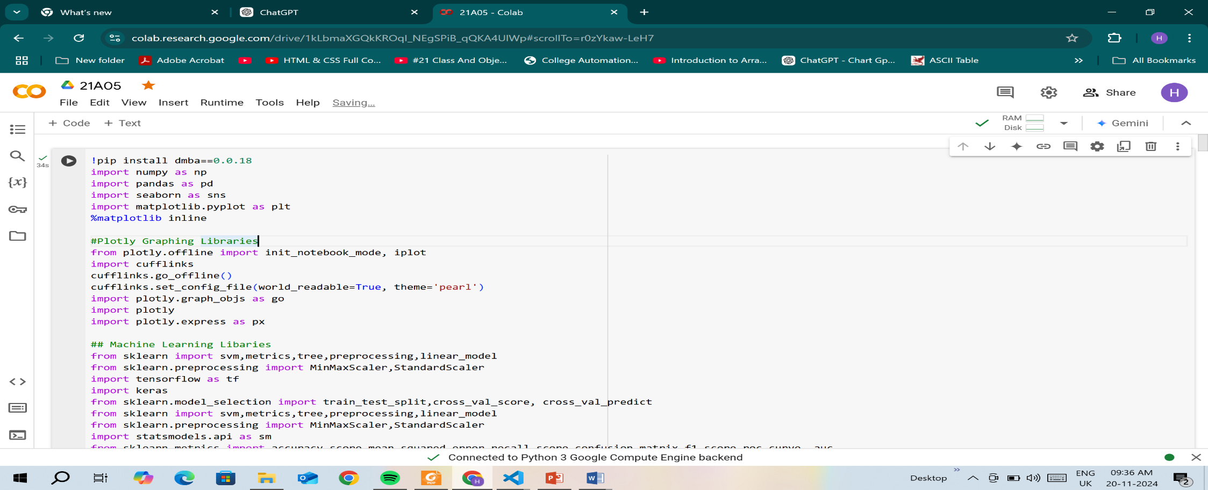
IMPLEMENTATION AND RESULTS

Slide 13
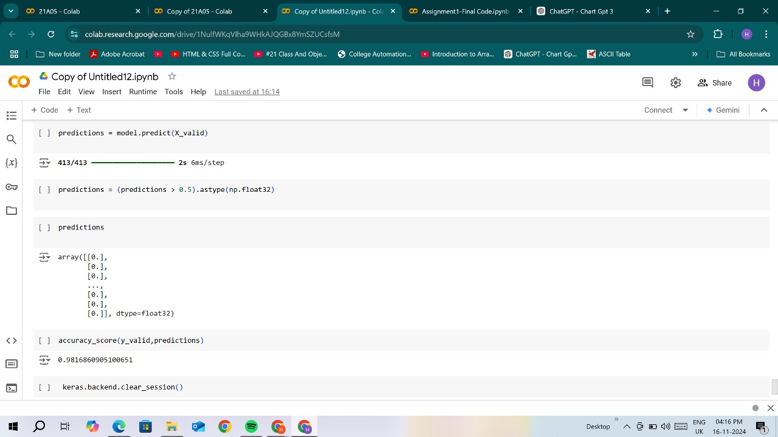

Slide 14
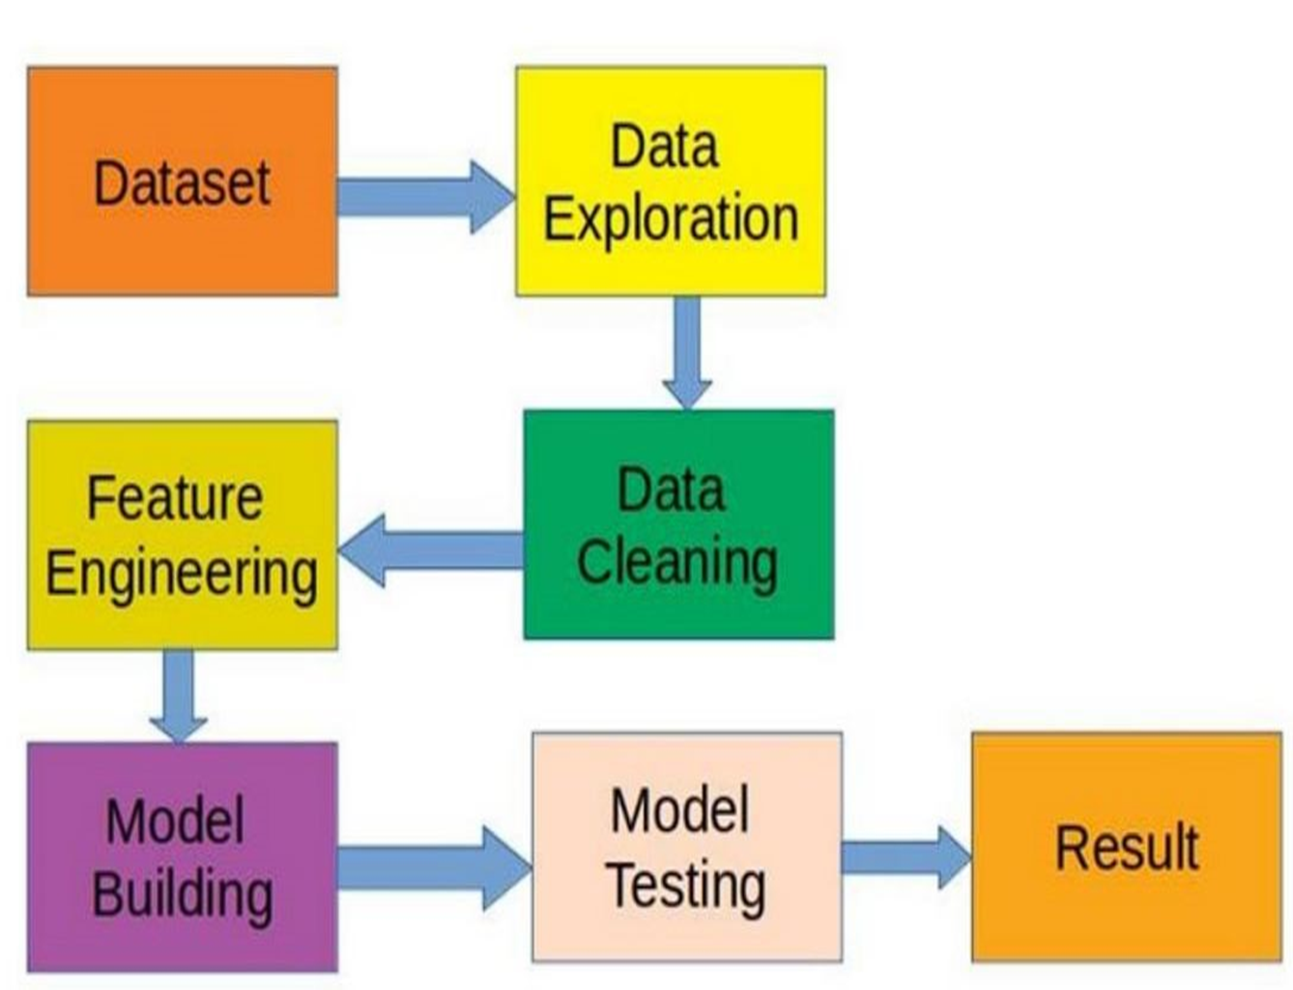

Slide 15
SYSTEM REQUIREMENTS
- Hardware Requirements:
Processor: Multi-core processor (e.g., Intel i5 or higher).
RAM: 8 GB or higher for smooth data processing.
Storage: 100 GB of free space to store datasets and project files.
GPU (optional): If using TensorFlow for neural networks, a dedicated GPU with CUDA support will speed up model training.
Operating System: Windows 10, macOS, or Linux.
- Software Requirements:
Python 3.6+: Minimum version for compatibility with modern libraries like Keras, scikit-learn, and TensorFlow.
Keras: For building and training neural networks.scikit-learn: For implementing the MLPClassifier and other machine learning models.
Pandas and NumPy: For data manipulation and numerical computations.Jupyter Notebook: For writing, running, and documenting the code.

Slide 16
References
Bolton, R. J., & Hand, D. J. (2002) - "Statistical Fraud Detection" - Used logistic regression and decision trees.
Dal Pozzuoli, A., et al. (2018) - "Credit Card Fraud Detection" - Applied random forests and decision tree
Kou, Y., et al. (2004) -Rule-based and clustering techniques for fraud detection”- Rule-based systems, clustering.
Phua, C., et al. (2010)- A comprehensive survey of fraud detection techniques”-Support vector machines (SVM), logistic regression.
Ngai, E. W., et al. (2011)-Data Mining Techniques in Financial Fraud Detection-Data mining and classification models.
Rifkin, J. & Klautau, A. (2004)-Naive Bayes, K-nearest neighbors (KNN)-Synthetic datasets for fraud detection

Slide 17


